Slide 1

PREDICTING CYCLIST TRAFFIC IN PARIS
Solal Zana & Adam Berdah

Slide 2

Sommaire
Project Presentation
EDA & Preprocessing
Model Selection
Evaluation of the final model
Future Research
Conclusion

Slide 3
I. PROJECT PRESENTATION
GOAL: Predict bike count at a given hour across 56 counters in Paris.
METRIC: Root mean square error (RMSE)
TIMEFRAME:
Training data: September 1st, 2020 – September 9th, 2021
Public Test data: September 10th, 2021 – October 18th, 2021
DATA:
training dataset partly fursnihed
Testing set: 50% public, 50% private.

Slide 4
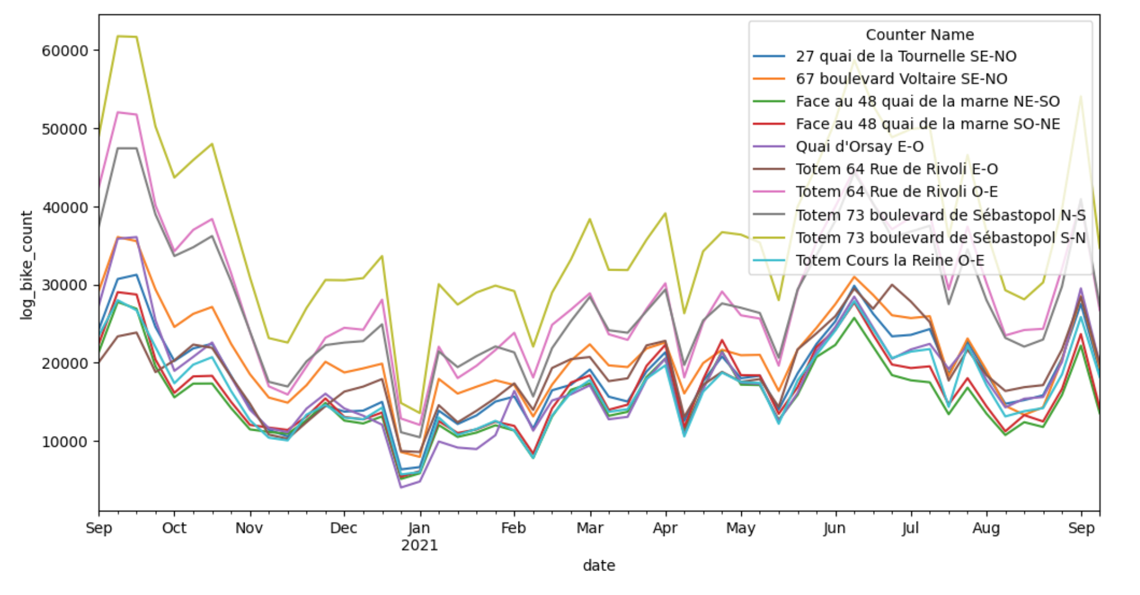
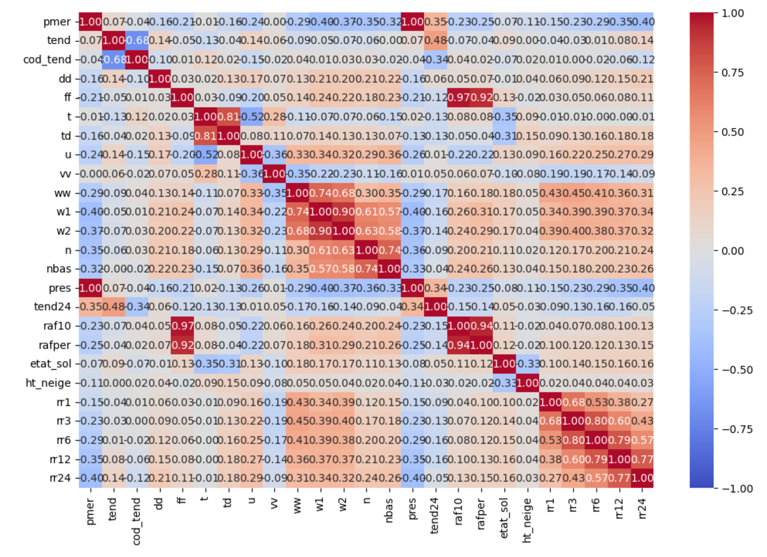
II. EDA
ADDING EXTERNAL DATA
Exploration:
Checked proportion of missing and unique values
Plotted relationships between features and target
Checked the correlation table

Slide 5
II. EDA
ADDING EXTERNAL DATA
Cleaning:
Missing values
Deleted columns containing > 10% missing values
Replaced the rest with the median
Deleted columns with a single value
Deleted some highly correlated columns
Added features:
French school holidays (zone C)
Bank holidays
Quarantines
Seasons
Distance from city center
ISSUE: merging both datasets gave a huge error (RMSE ≈ 2.15)

Slide 6
II. EDA
ENCODING
Standard Scaler | One-Hot | Cyclical encoding
All numerical columns | Counter name Years Weekday | Hour Day Weekday Month

Slide 7
IV. MODEL EXPERIMENTATION & SELECTION
Models tested:
Ridge Regression
Random Forest
XGBoost
Catboost
LightGBM
Evaluated model performance on XGBoost using cross-validation and RMSE as metrics.
Grid Search on the most probant model

Slide 8
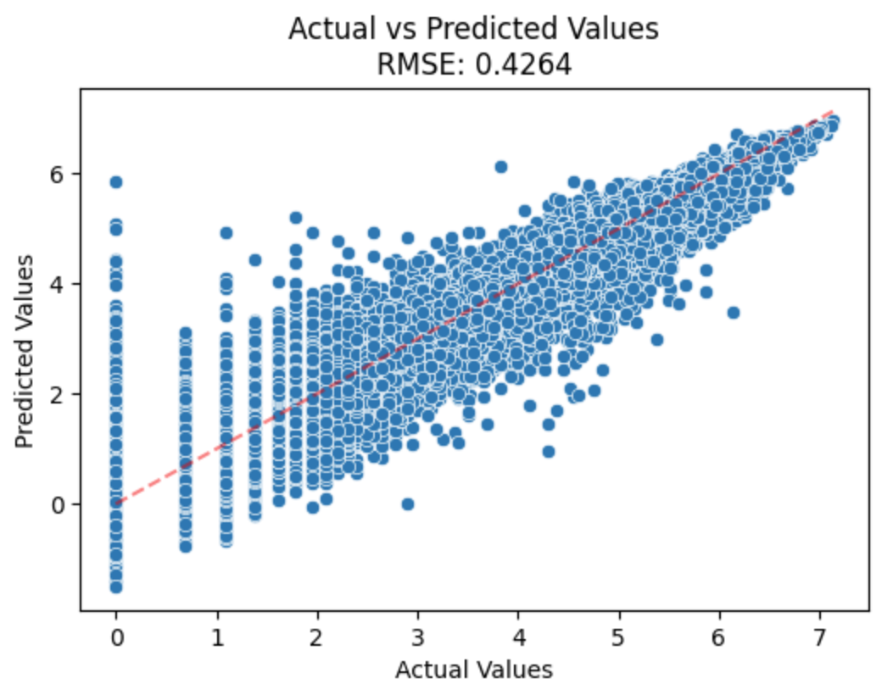
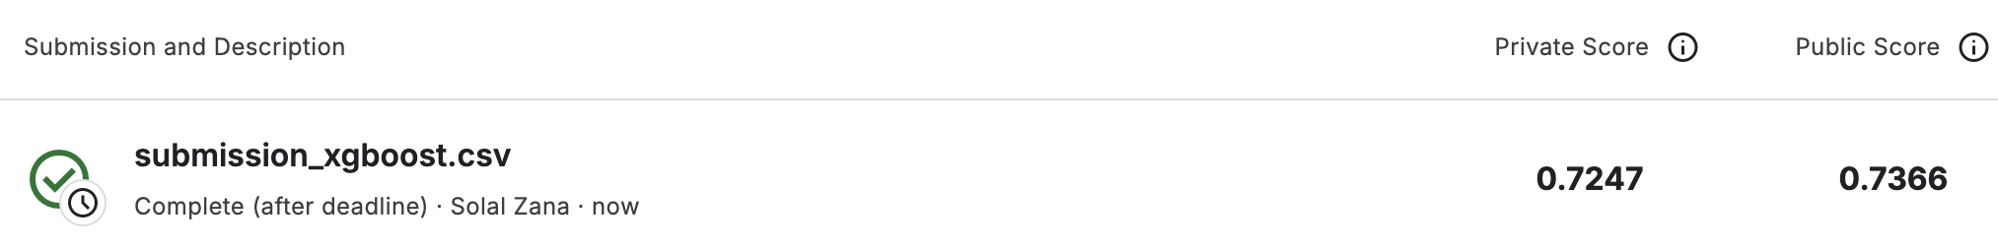
V. EVALUATION OF FINAL MODEL
OUR FINAL BEST RESULT:

Slide 9
VI. Future research
Analysis of construction work iin Paris from additional datasets ?
Test other types of encoders ?
Gap encoder or Target encoder
Integrating additional data like geographical traffic density or inhabitants density
Exploring neural networks

Slide 10
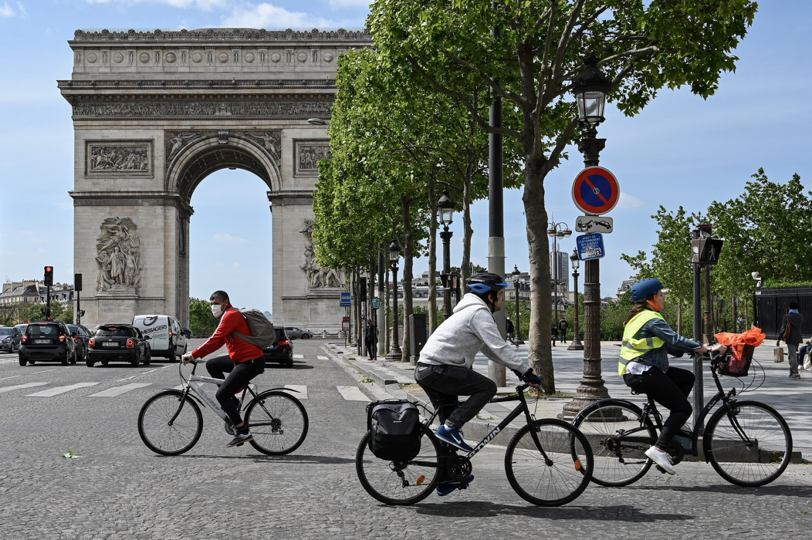
Thank you for your attention

